Slide 1

Résumé Improvement
Rule Breakers
Buyang Li, Huihui Zhang,
Jiayu Zhang, Yuxuan Li, Eshan Sharmarma
December 8th 2021

Slide 2
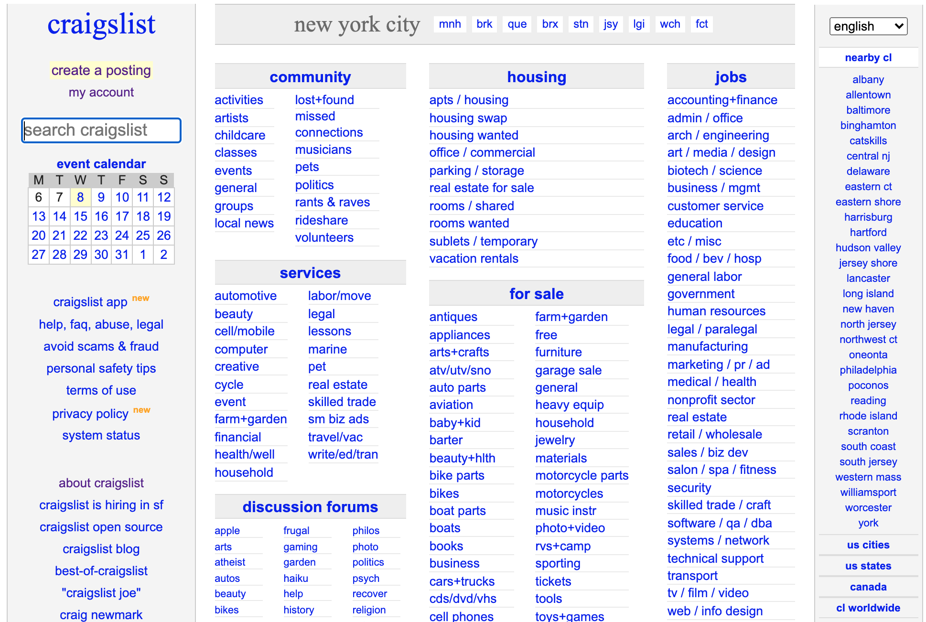

Slide 3

Agenda
A
B
Business Background
and Problems
Project Objectives
C
D
Data Analysis
Conclusion & Recommendation

Slide 4
Background
One of the biggest classified advertisements
Users can easily post their needs in whatever voice and format they want for free
This flexibility allows Craigslist to be a humane and uncommercial environment
High costs in retrieving relevant information for ad-viewers.

Slide 5
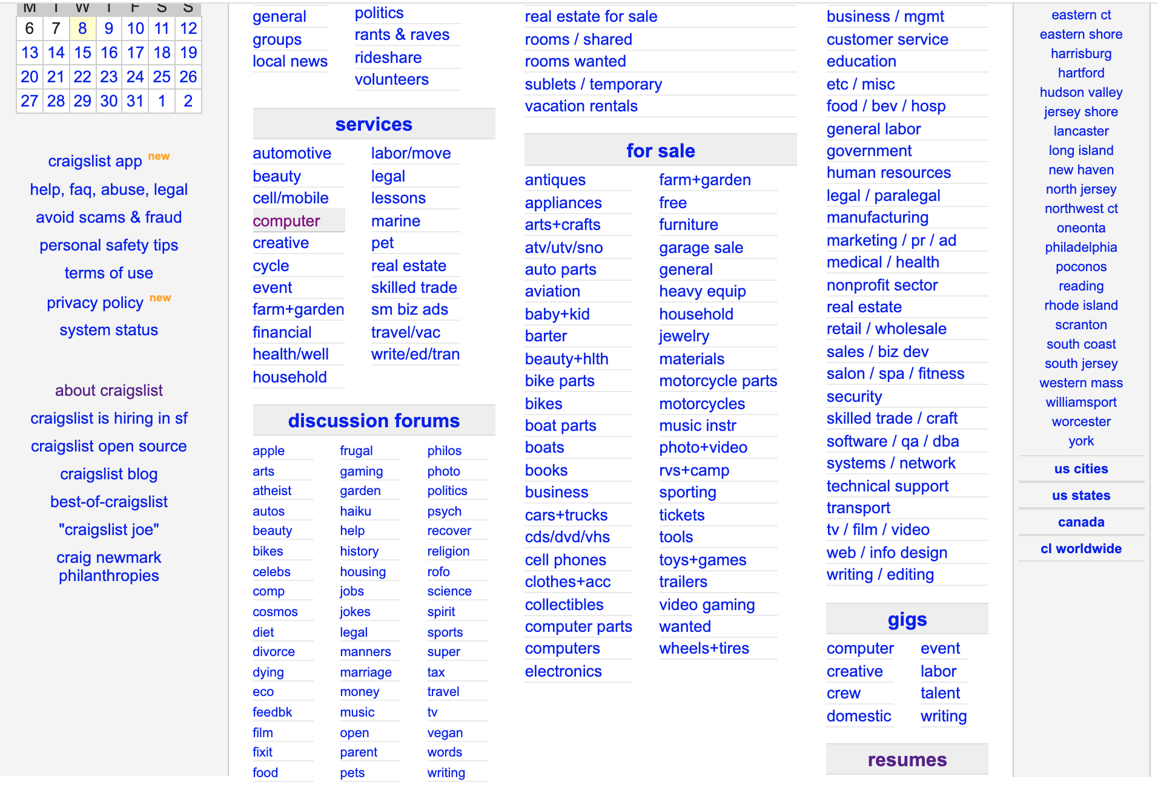
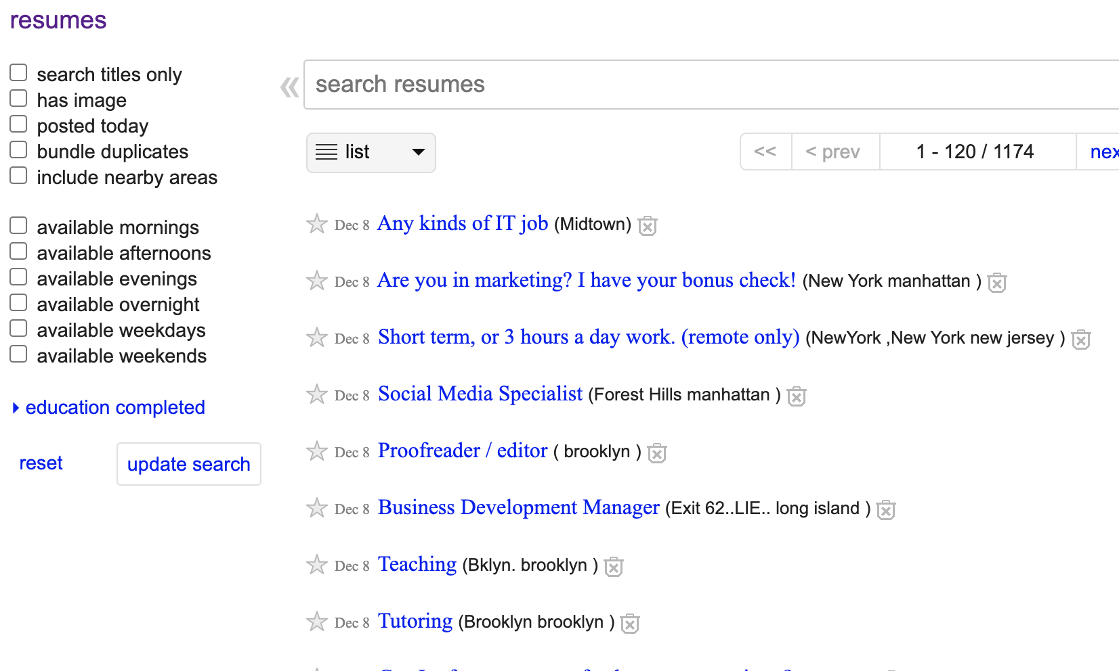
Résumés Section

Slide 6
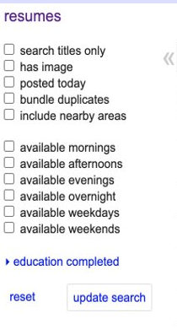



Business problem
01
02
Résumés v.s. Non-Résumés
No job type classification
Only be classified by city, working availability, educational level, and licensed information.
No filter functionality or subdivisions that help ad-viewers to quickly locate what they want.

Slide 7
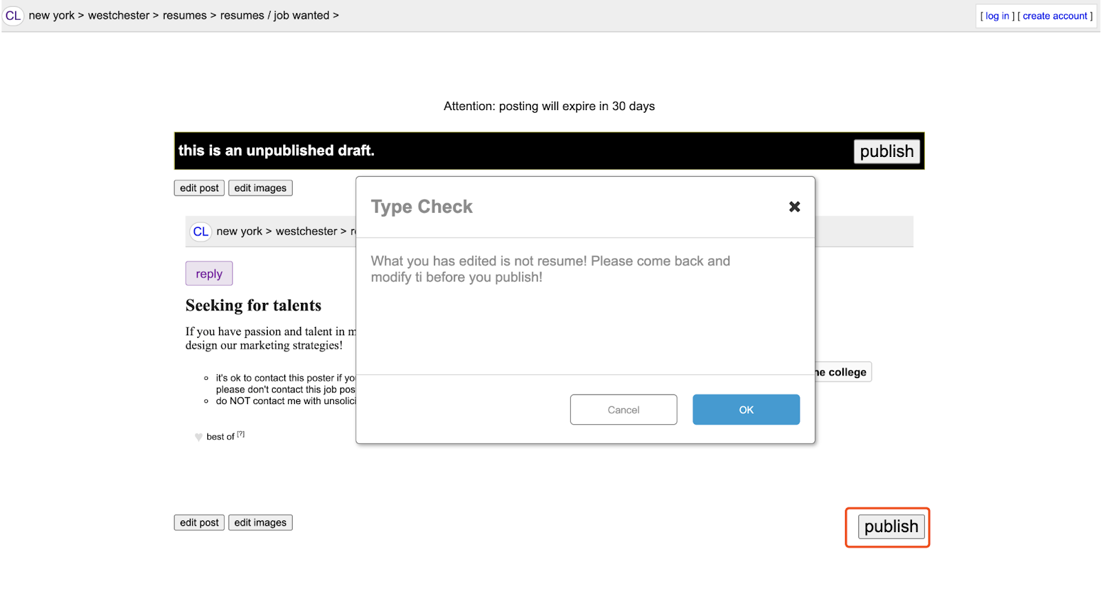
Project Objective
Reduced/No misclassification
Help Craigslist to identify if it is a real résumé or not. Real résumés will be posted successfully and a fake résumé will not be posted and users will be informed that they need to modify their posts.

Slide 8
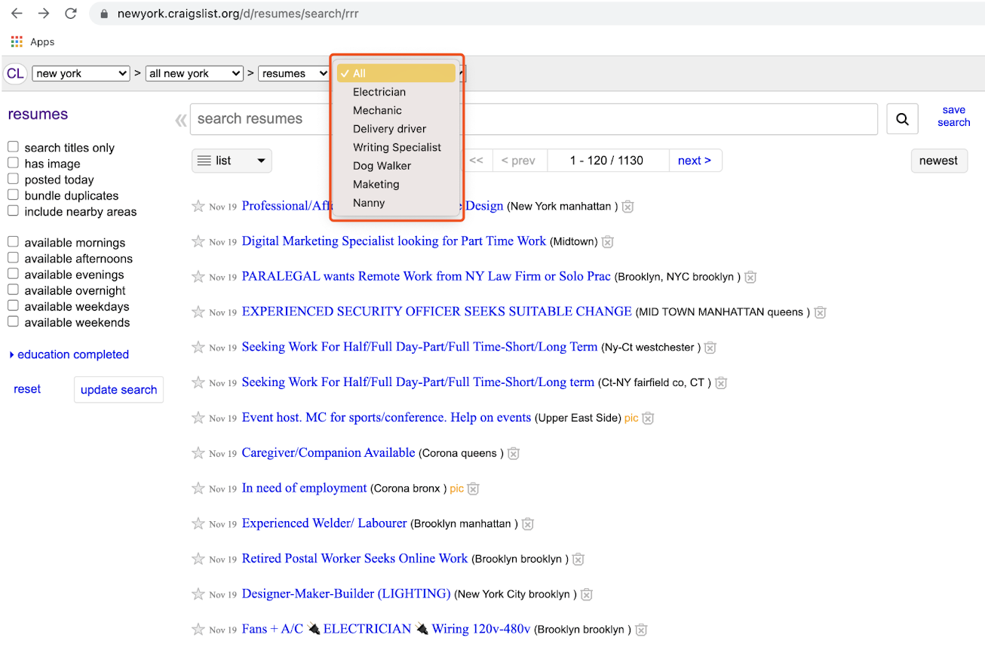
Project Objective
Add job type filters
Resumes will be automatically added to the suitable subcategory that help employers quickly target the correct group of the working candidates

Slide 9
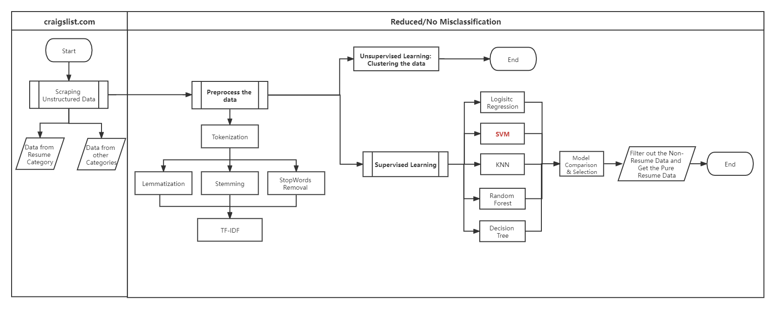
Stage 1: Reduced/No misclassification
Overview of Process

Slide 10
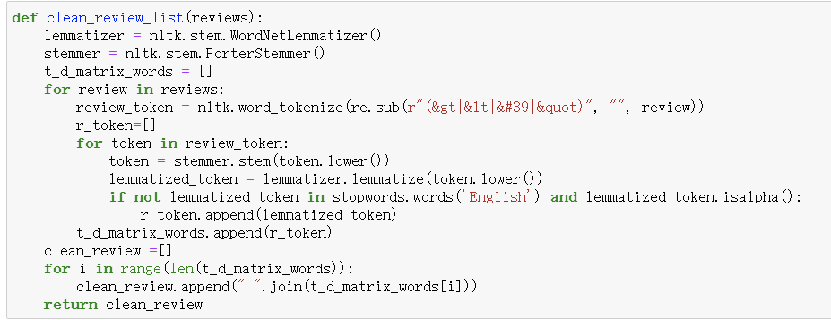
Stage 1: Reduced/No misclassification
Step 1:
Data Scrapping: Scrapped 2000 Résumé data and 2000 Non-Résumé data using Beautiful Soup and URLlib.
Preprocessing: Tokenization, lemmatization, stemming, Stop words removal, TF-IDF with 1 and 2 grams.

Slide 11
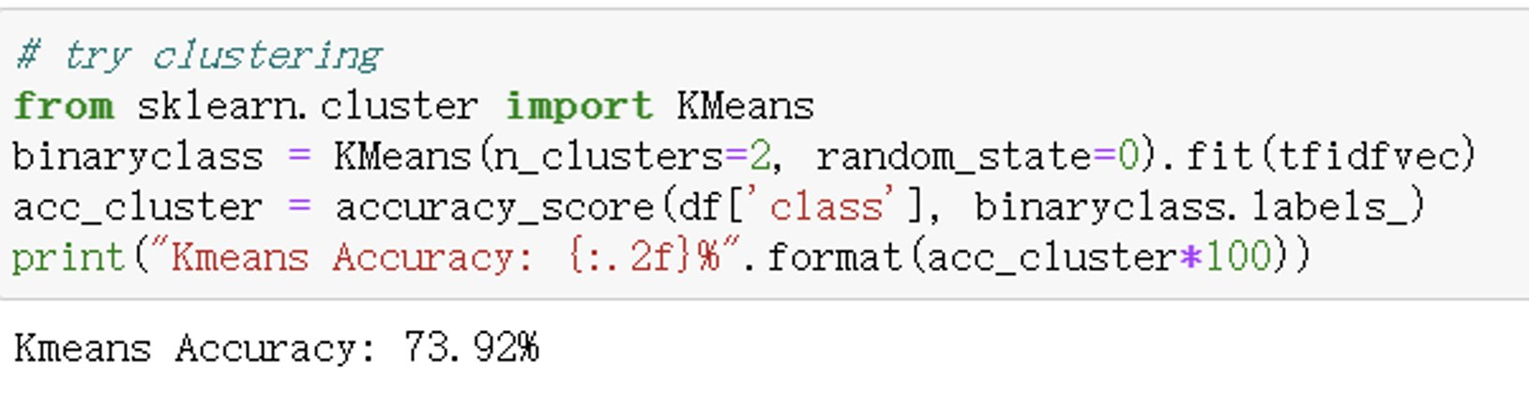
Stage 1: Reduced/No misclassification
Step 2
Unsupervised learning: Used K-means and LDA methods to cluster the dataset. However, the clustering result is under our expectation.

Slide 12
Stage 1: Reduced/No misclassification
Step 3
Labeling: Manually label the data from the resume section as “resume” and the data from other sections on Craigslist as “non-resume”. Combining the two dataset.
Supervised Learning: Used SVM, Logistic Regression, KNN, Decision Tree, Random Forest to train the dataset.

Slide 13
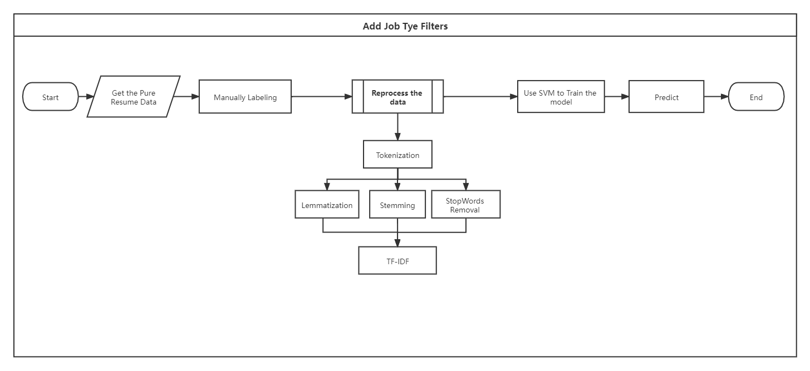
Stage 2: Add Job Type Filters
Overview of Process

Slide 14

Stage 2: Add Job Type Filters
Step 1:
Data preparation: Used the previously trained model to filter out the non-résumés posting and obtain a clean resume dataset.
Labeling: Manually looking for job type related keywords in the résumés dataset and decided the 16 job types.
Re-processing the data: Used Tokenization, lemmatization, stemming, Stop words removal, TF-IDF with 1 and 2 grams to re-processing the résumé data.

Slide 15
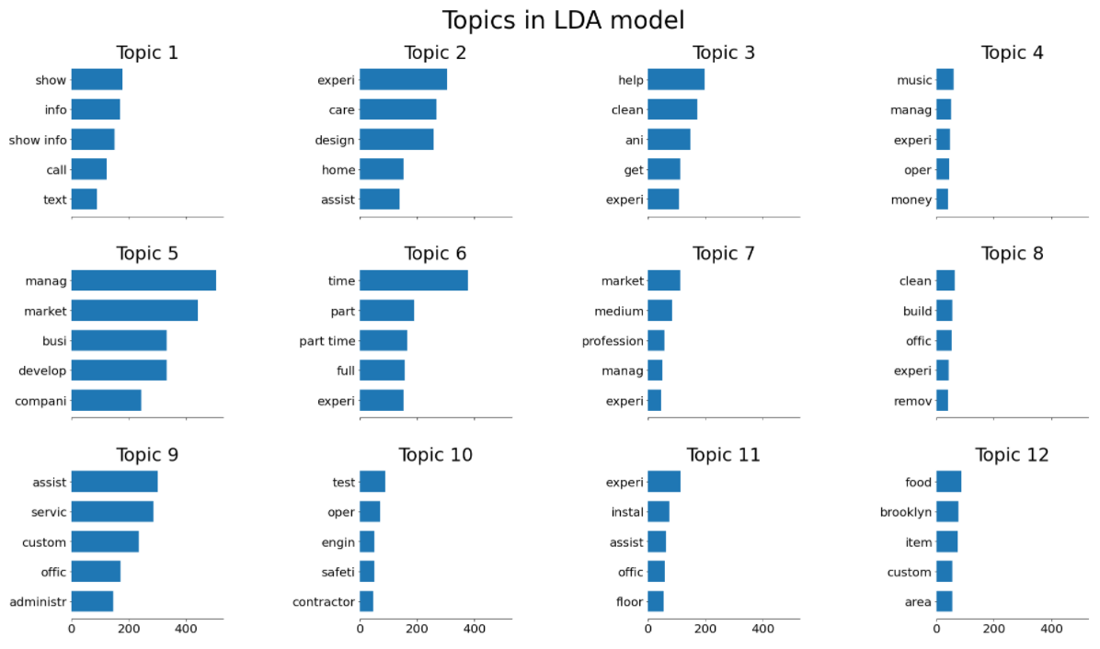
LDA:
Stage 2: Add Job Type Filters

Slide 16
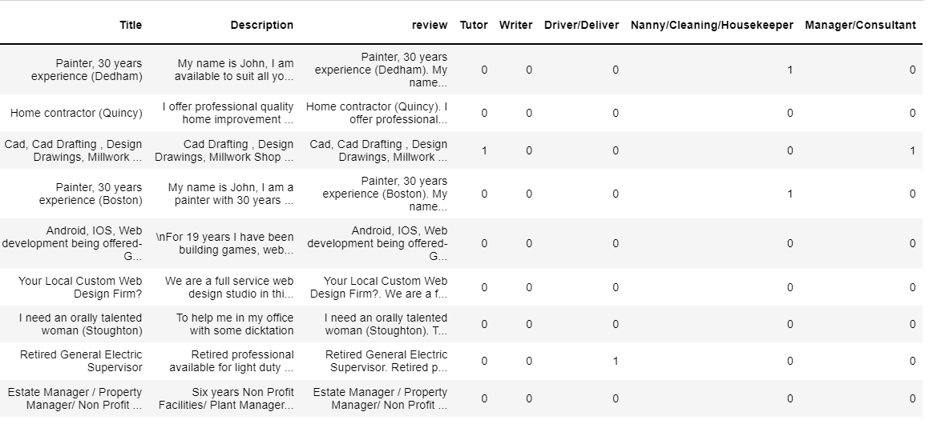
Label Matrix:
Stage 2: Add Job Type Filters

Slide 17
Step 2:
Split the dataset: Set 80% as train data and 20% as validation data.
Train the model: Using the best model SVM in Stage 1 to train the model.
Stage 2: Add Job Type Filters

Slide 18
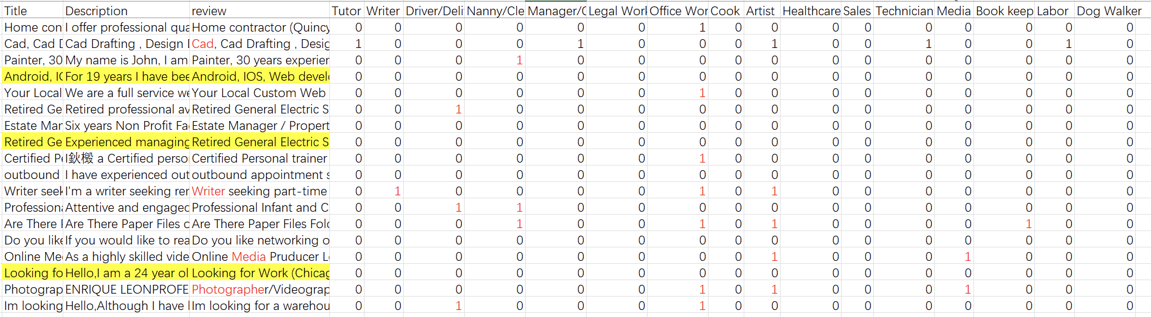
Step 3:
Test the model: Scrap some data from different cities and manually check if our model performs well.
Stage 2: Add Job Type Filters

Slide 19
Conclusion & Recommendation
Conclusion:
The best Model: SVM
Outcome of Stage 1: Allow Craigslist to arrange users' posts more accurately
Outcome of Stage 2: Allow Recruiters to find suitable candidates more efficiently using the filter
Recommendation:
Apply our model to every subcategories not just the Resume section.
Realize the job type filter on UI

Slide 20

Thank you!
Q & A ?
Link: new york resumes - craigslist

